Slide 1
CHAMPS
ICONS and Reproducibles

Slide 5
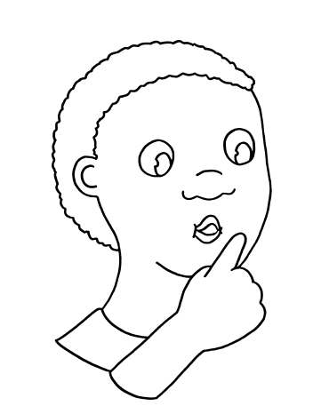
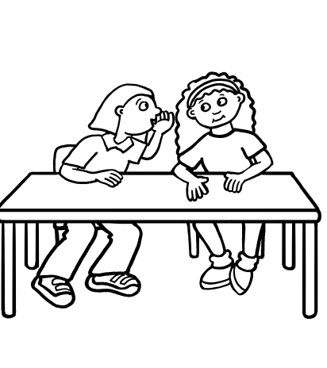
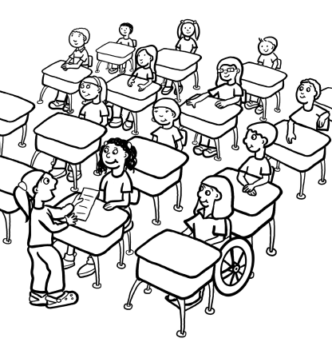
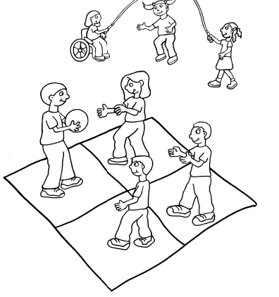
Voice Levels

Slide 6
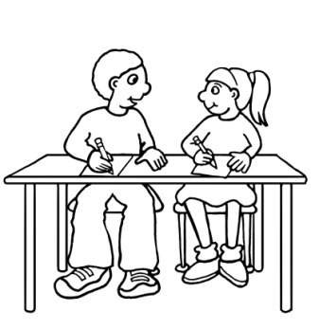
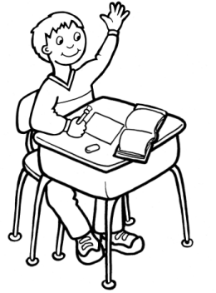
Conversation
Talk with another student
Talk quietly with your group.
Raise your hand and wait for you to be called on.
No talking

Slide 7
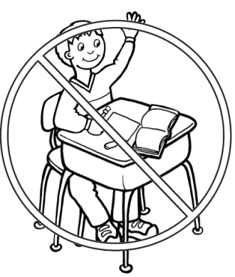
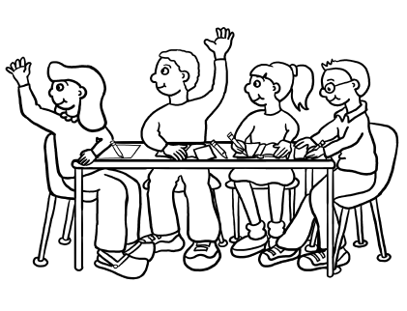
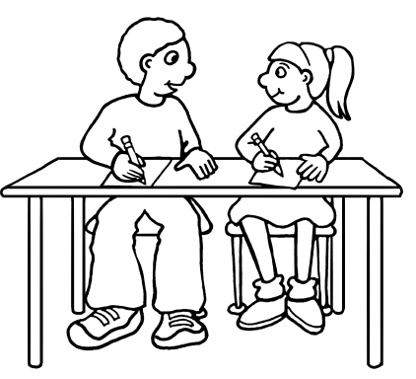
Help
Ask anyone in your group
In a group 2 Raise Hand
No Help except in emergency
Raise Hand
Ask your shoulder buddy.

Slide 8
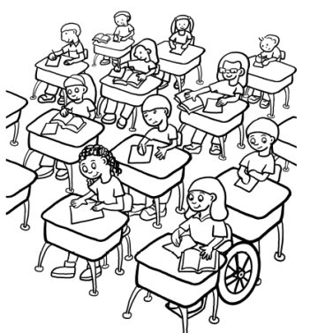
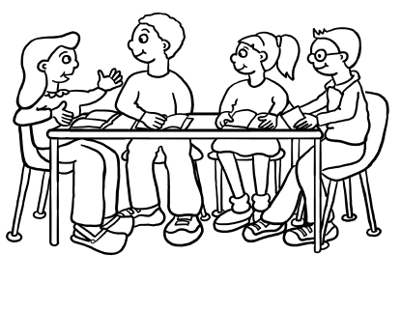
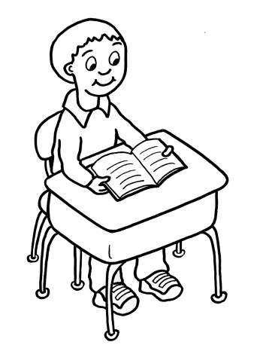
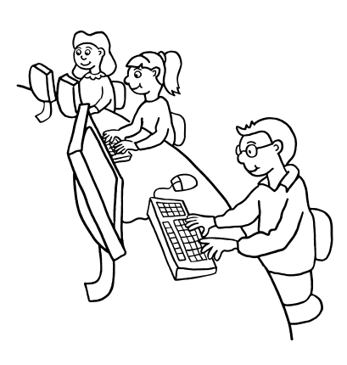
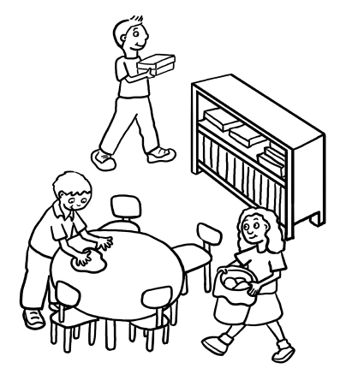
Activity
Independent Seatwork no Teacher help
Cooperative Groups
Independent Seatwork w/ Teacher
Computer Lab
Clean Up
Silent Reading

Slide 9
Activity
Independent Seatwork no Teacher help
Cooperative Groups
Independent Seatwork w/ Teacher
Computer Lab
Clean Up
Silent Reading

Slide 10
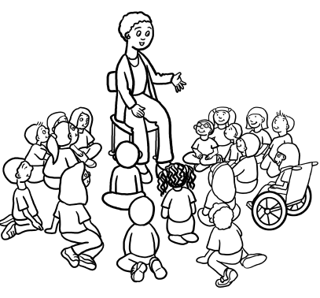
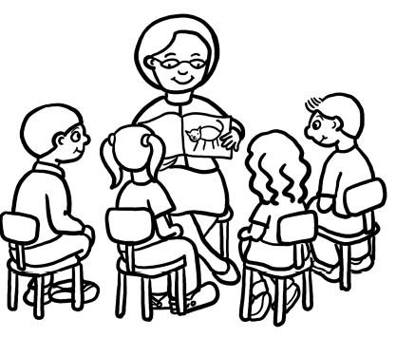
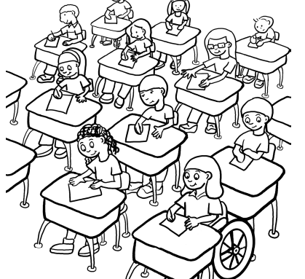
Activity 2
Small Group Instruction
Class at Rug
Whole Class Instruction
Test

Slide 11
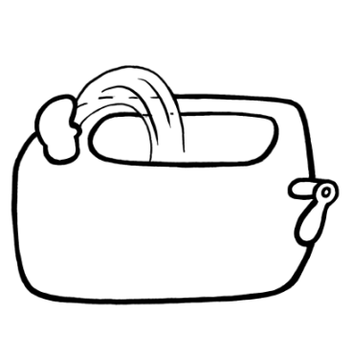
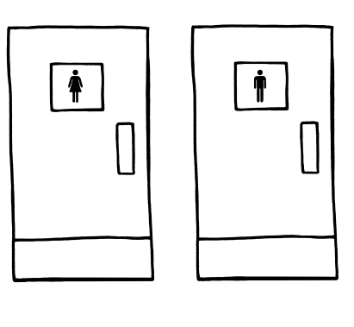
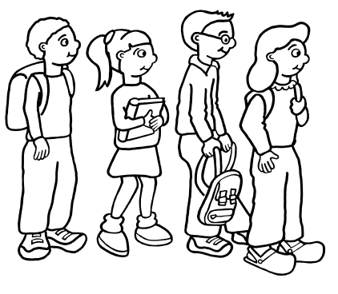
Movement
May not Sharpe pencil
May Sharpen Pencil
May turn in work
May drink water
May Use Bathroom
May line up

Slide 12
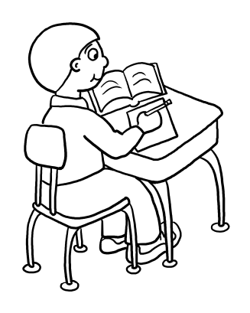
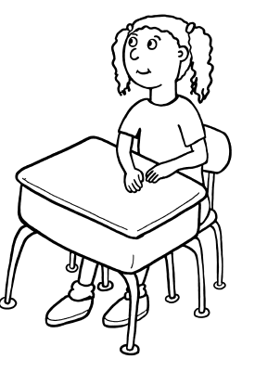
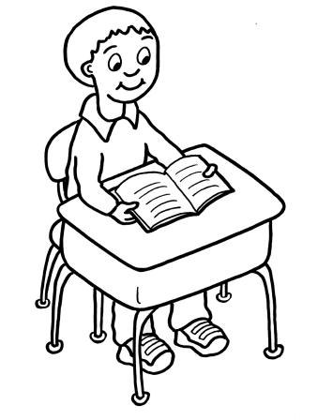
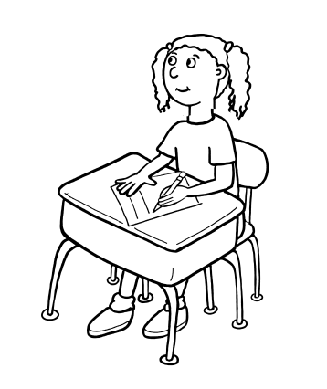
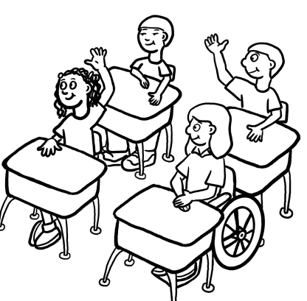
Participation
Write
Listen
Read
Talk respectfully and quietly with one another. Listen when one person talks.
Listen and Take Notes
Listen, answer/ ask questions

